Slide 1
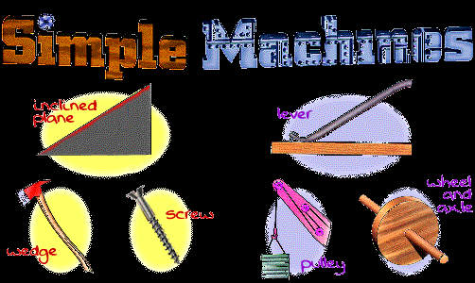
Work and Simple Machines

Slide 2
Energy
Energy- the ability to do work.
  Potential Energy- stored energy
  Kinetic Energy- energy due to motion
Mechanical Energy- the ability to make something move

Slide 3
Motion
What exactly is motion?
  Motion is the change in an object’s position
  The change in position is determined by a reference point, or a “starting point”
    It is a fixed location, it does not change, from which you can determine the movement of an object

Slide 4
Distance
Distance is the measured space between two points, how much an object travels

Slide 5
Distance & Position
A
B
-10
-5
0
5
10
15
20
25
Can you state the distance
between the two cars?

Slide 6
Speed
The speed of an object is the distance the object travels per unit of time.
  Speed is a rate of change in distance over a given time period
Speed=distance ÷ time

Slide 7
Speed
-10
-5
0
5
10
15
20
25
meters
Time = 0 seconds

Slide 8
Speed
-10
-5
0
5
10
15
20
25
meters
Time = 5 seconds

Slide 9
Speed
-10
-5
0
5
10
15
20
25
meters
Time = 10 seconds

Slide 10
Speed
-10
-5
0
5
10
15
20
25
meters
Time = 15 seconds

Slide 11
Speed
The car traveled a total of approximately 20 meters in a total of 15 seconds, at what speed was the car traveling?
  Speed= distance ÷ time
  Distance= 20 meters
  Time= 15 seconds
  Speed= 20 m ÷ 15 s
  Speed= 1.33 m/s

Slide 12
Constant & Average Speed
constant speed is the speed that does not change.
Average speed is the total by time. distance divided
Instantaneous speed is the rate of movement at one particular time, in an instant

Slide 13
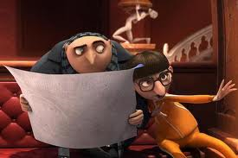
Velocity
Velocity is the distance an object moves over a given time in a particular direction.
  It is speed in a given direction
Velocity is a vector quantity.
  It has both magnitude and direction
Vector- committing crime with both magnitude and direction…

Slide 14
Acceleration
Acceleration is the change in velocity over a given period of time
  How fast does something move over a given period of time
  It can be a vector quantity- give direction- or simply scalar- not direction given

Slide 15
Force
Force is a push or pull on an object
Friction- is a force that prevents an object from moving
  Friction must be overcome to allow an object to move

Slide 16
Momentum
Momentum is determined by both the velocity and the mass of an object
  It is the product of mass and velocity
    (mass x velocity)

Slide 17
Newton’s Laws of Motion
Galileo Galilei- contrary to scientific teachings of his time, introduced the idea that moving objects will not stop moving unless something stops them
Years later Sir Isaac Newton developed the laws of motion we use today to explain how and why objects move

Slide 18
Newton's 1st Law of Motion
An object at rest tends to stay at rest and an object in motion tends to stay in motion with the same speed and in the same direction (velocity) unless acted upon by an unbalanced force.
sometimes referred to as the "law of inertia.”
Gravity is an important force to be considered here on earth, because although an object appears to stop or start movement on its own it is the force of gravity that is in effect
Friction is also a major factor in movement

Slide 19

Example of 1st Law of Motion
  Pendulum is a example for Newton's first law
  Once its in motion its always in motion.
  Once its at rest its always at rest.

Slide 20
Newton's 2nd Law of Motion
The second law states that the acceleration of an object is dependent upon two variables - the net force acting upon the object and the mass of the object.
Force=mass x acceleration

Slide 21
Newton’s 2nd Law of Motion
The greater the mass of an object, the greater the force needed to move that object.
The greater the force exerted on an object the greater its acceleration will be.
The greater the acceleration, the greater the force exerted on an object.

Slide 22

Newton’s 3rd Law of Motion
A force is a push or a pull upon an object which results from its interaction with another object.
Forces come in pairs, for every action there is an equal and opposite reaction
“the law of action-reaction”

Slide 23

Work, Force , and Mechanical Advantage
Work
Exerting forces on the object than causes the same object to move some direction
To work you must move some distance

Slide 24
What’s work?
A scientist delivers a speech to an audience of his peers.
A body builder lifts 350 pounds above his head.
A mother carries her baby from room to room.
A father pushes a baby in a carriage.
A woman carries a 20 kg grocery bag to her car?

Slide 25
What’s work?
A scientist delivers a speech to an audience of his peers. No
A body builder lifts 350 pounds above his head. Yes
A mother carries her baby from room to room. No
A father pushes a baby in a carriage. Yes
A woman carries a 20 kg grocery bag to her car? No

Slide 26
Formula for work
Work = Force x Distance
The unit of force is newtons
The unit of distance is meters
The unit of work is newton-meters
One newton-meter is equal to one joule
So, the unit of work is a joule

Slide 27

W=FD
Work = Force x Distance
Calculate: If a man pushes a concrete block 10 meters with a force of 20 N, how much work has he done?

Slide 28
W=FD
Work = Force x Distance
Calculate: If a man pushes a concrete block 10 meters with a force of 20 N, how much work has he done? 200 joules
(W = 20N x 10m)

Slide 29
Simple Machines
Simple machines: any object that makes work easier
    Wheels and axles
    Gears
    Pulleys
    Inclined planes
    Wedges
    Screws

Slide 30
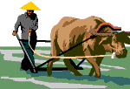
History of Work
Before engines and motors were invented, people had to do things like lifting or pushing heavy loads by hand. Using an animal could help, but what they really needed were some clever ways to either make work easier or faster.

Slide 31
Simple Machines
Ancient people invented simple machines that would help them overcome resistive forces and allow them to do the desired work against those forces.

Slide 32

The 3 Classes of Levers
The class of a lever is determined by the location of the effort force and the load relative to the fulcrum.

Slide 33
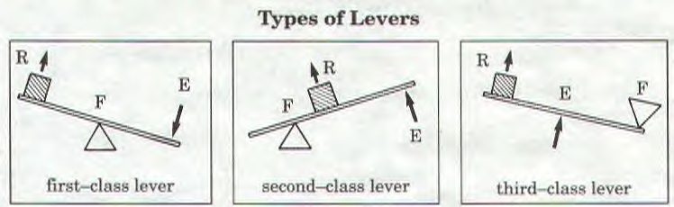
There are 3 classes of levers.

Slide 34
First Class Lever
In a first-class lever the fulcrum is located at some point between the effort and resistance forces.
  Common examples of first-class levers include crowbars, scissors, pliers, tin snips and seesaws.

Slide 35
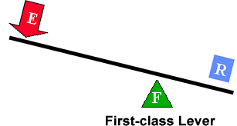
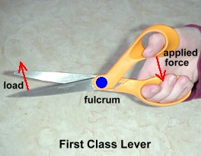
There are 3 classes of levers.
First class lever
  The fulcrum is somewhere between the resistance and effort
  Examples include crowbar, scissors

Slide 36
Second Class Lever
With a second-class lever, the load is located between the fulcrum and the effort force.
Common examples of second-class levers include nut crackers, wheel barrows, doors, and bottle openers.

Slide 37
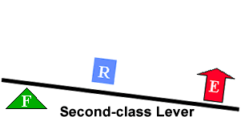
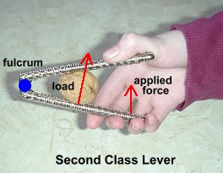
There are 3 classes of levers.
Second class lever
  The fulcrum is nearest to the resistance.
  Ex: bottle opener, boat oars, wheel barrow

Slide 38
Third Class Lever
With a third-class lever, the effort force is applied between the fulcrum and the resistance force.
  Examples of third-class levers include tweezers, hammers, and shovels.

Slide 39
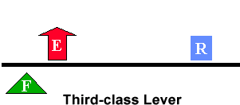
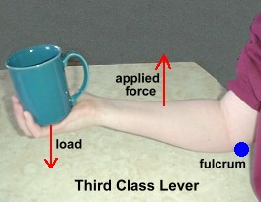
There are 3 classes of levers.
Third class lever
  The fulcrum is nearest to the effort
  Ex: baseball bat, golf club, broom

Slide 40
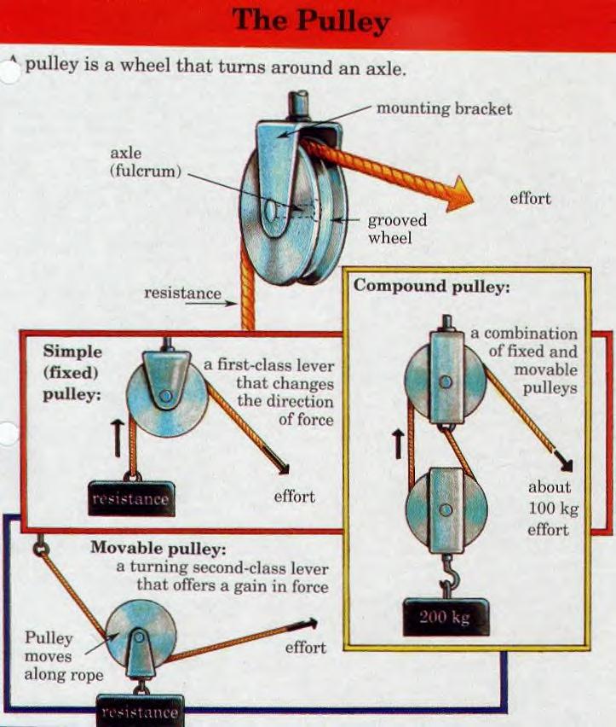
Pulley
A pulley consists of a grooved wheel with a chain or a rope in the groove .
A fixed pulley does not move, it does not rise or fall with the load being moved. It makes work easier by changing direction of force but does not reduce force needed to move the object.
A moveable pulley rises and falls with the load that is being moved. Fixed pulleys produce a gain in force.
A block and tackle combines multiple fixed and movable pulleys.
Mechanical advantage is the decrease in effort that is needed to move an object.

Slide 41
Wheel and Axle
The wheel and axle is a simple machine consisting of a rod, or axle, running through a wheel.
When either the wheel or axle turns, the other part also turns.

Slide 42
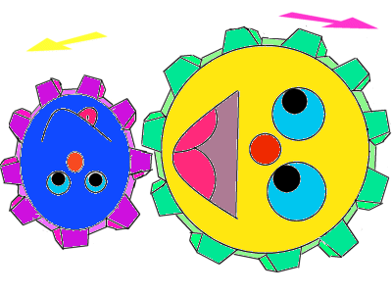
Wheel and Axle
A gear is a special wheel and axle that has tooth-like projections that interlock with either another gear or a chain to increase force applied.

Slide 43
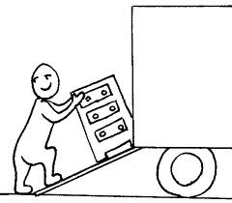
Inclined Plane
An inclined plane is a flat, slanted surface; like a ramp.
An inclined plane makes it easier to move a weight from a lower to higher elevation.

Slide 44
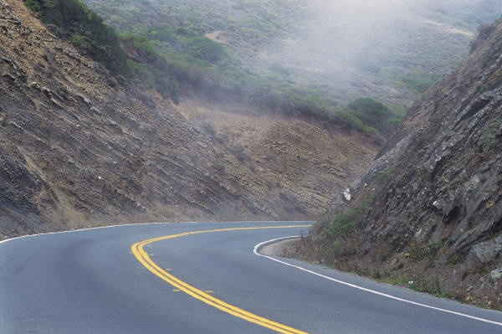
Inclined Plane
A wagon trail on a steep hill will often traverse back and forth to reduce the slope experienced by a team pulling a heavily loaded wagon.
This same technique is used today in modern freeways which travel winding paths through steep mountain passes.

Slide 45
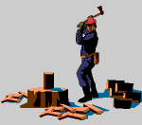
Wedge
The wedge is a modification of the inclined plane.
It is 2 inclined planes placed back-to-back
Wedges are used as either separating or holding devices.
Examples include knives, axes, or door-stops

Slide 46
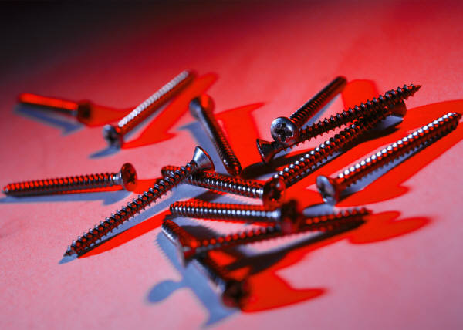
Screw
The screw is also a modified version of the inclined plane.
While this may be somewhat difficult to visualize, it may help to think of the threads of the screw as a type of circular ramp (or inclined plane).

Slide 47
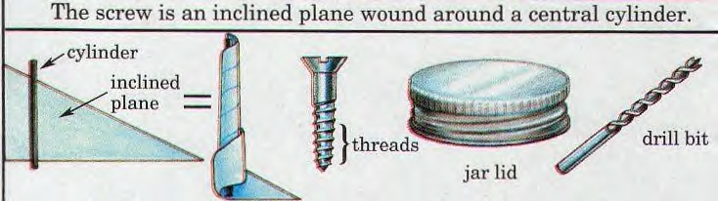
Inclined Planes

Slide 48
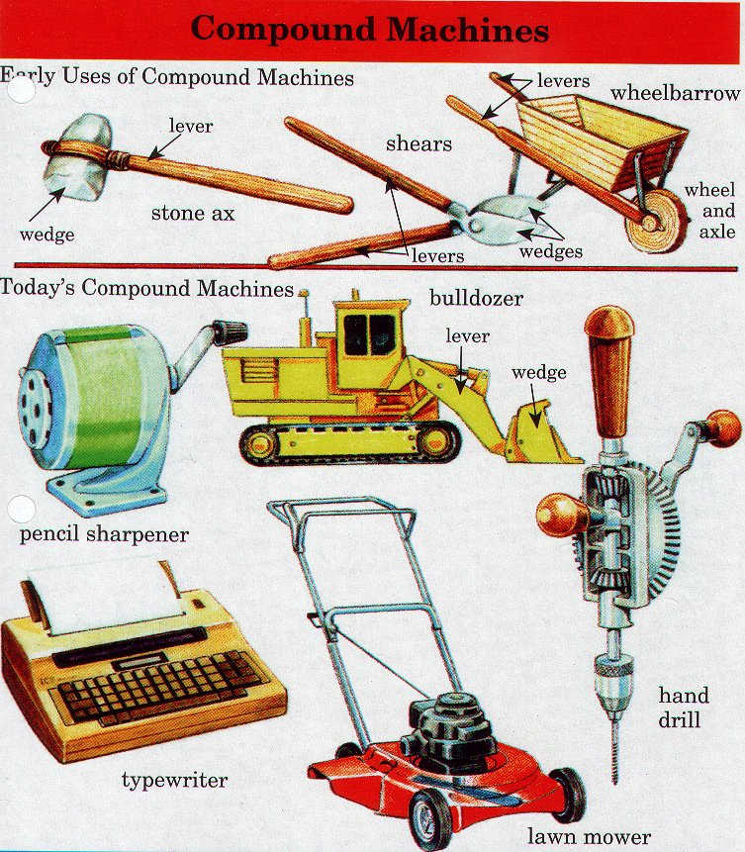
Compound Machines
A compound machine is two or more simple machines combined together to make work even easier.

Slide 49
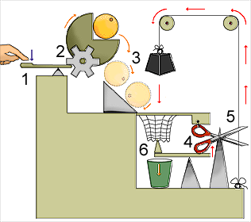
Compound Machines

