Slide 1
Internal Balance

Slide 2
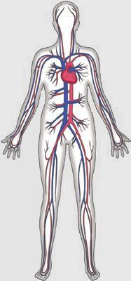
Circulatory System

Slide 3
What is the circulatory system?
The circulatory system carries blood and dissolved
substances to and from different places in the body.
The Heart has the job of pumping these things around
the body.
The Heart pumps blood and substances around the
body in tubes called blood vessels.
The Heart and blood vessels together make up the
Circulatory System.

Slide 4
Transportation system by which oxygen and nutrients reach the body's cells, and waste materials are carried away.
What is the circulatory system?

Slide 5
Also carries substances called hormones, which control body processes, and antibodies to fight invading germs.
What is the circulatory system?

Slide 6

Functions of the circulatory system:
Distribute nutrients,
Transport and exchange oxygen and carbon dioxide,
Remove waste materials,
Prevent excessive bleeding,
Prevent infection, and
Regulate body temperature.

Slide 7
Parts of the Circulatory System
Divided into three major parts:
  The Heart
  The Blood
  The Blood Vessels

Slide 8
Three Kinds of Blood Vessels
Arteries
Veins
Capillaries

Slide 9
Arteries
Carry blood AWAY from the heart
Heart pumps blood
Main artery called the aorta
Aorta divides and branches
Many smaller arteries
Each region of your body has system of arteries supplying it with fresh, oxygen-rich blood.

Slide 10
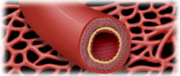
Arteries
Have strong, muscular walls
The inner layer is very smooth so that the blood can flow easily

Slide 11
Capillaries
Very thin
Only one cell thick
Connect arteries & veins

Slide 12
Capillaries
Food and oxygen released to the body cells
Carbon dioxide and other waste products returned to the bloodstream

Slide 13
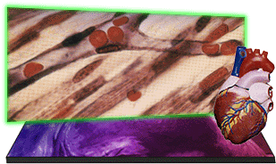

Slide 14
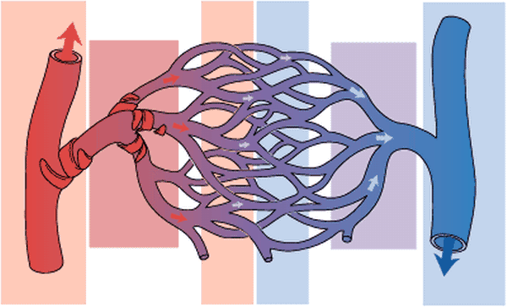

Slide 15
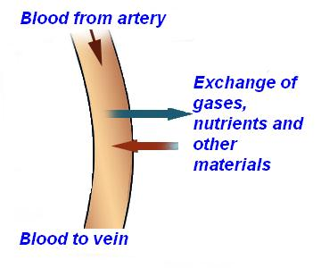

Slide 16
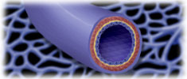
veins
Veins contain valves that only allow blood to flow in one direction (just like the heart)!

Slide 17
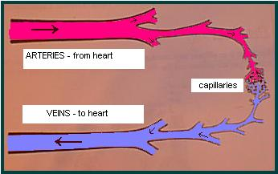

Slide 18
Veins
Carry blood to the heart
Receive blood from the capillaries
Transport waste-rich/ oxygen-poor blood back to the lungs and heart
Valves are located inside the veins
Allow blood to move in one direction

Slide 19
The Structure of the Heart
The heart is actually a muscle
  It should be approximately the size of your fist
  Your heart beats approximately 70-80 beats each minute at rest (consciously) (average for healthy people)
  When you exercise it beats faster- because your body needs more oxygen
  When asleep your heart rate slows

Slide 20
The Structure of the heart
The human heart has 4 chambers:
  2 atria- top of the heart; thin-walled chambers
    Left atrium
    Right atrium
  2 ventricles- bottom of the heart; thick-walled chambers
    Left ventricle
    right ventricle
  Septum- thick wall separating the left and right sides of the heart

Slide 21
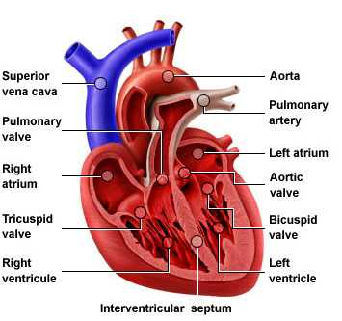

Slide 22
The Structure of the Heart
There are valves separating the atria and ventricles
  Atrioventricular valves- flaps of tissue separating the atrium from the ventricle
    One way valves, meaning that there can be no back flow (blood flows into the ventricle and cannot flow back into the atrium)

Slide 23
The Structure of the Heart
Semilunar valves- located at the beginning of the large vessels that carry blood away from the heart
  These are one-way valves, once blood is pumped out of the ventricle into the pulmonary arteries/aorta they cannot come back into the ventricle

Slide 24
The Path of Blood
Superior Vena Cava- this is where blood returns to the heart from the upper portion of the body into the right atrium
Inferior Vena Cava- this is where blood returns to the heart from the lower portion of the body into the right atrium
The right atrium then pumps the deoxygenated blood into the right ventricle which pumps it to the lungs

Slide 25
The Path Of Blood
From the right ventricle blood is pumped through the pulmonary arteries to the lungs to get OXYGEN!!!!!
Once the blood has been oxygenated it is pushed back to the heart via the pulmonary veins into the left atrium.
The left atrium pumps the blood into the left ventricle and then to the body via the aorta

Slide 26
The Path of Blood
Once the blood is pumped out of the heart through the aorta to the body it goes through the body via arteries, where is provides oxygen to the entire body
When it has given that portion of the body its oxygen, it is pumped through the capillaries to the veins, where it will return to the heart

Slide 27
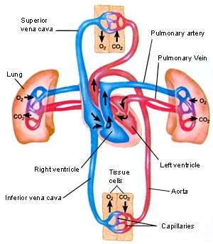

Slide 28
Blood Flow to the Heart Muscle
The left and right coronary arteries immediately branch from the aorta and carry fresh blood to the heart muscle itself.
The coronary veins quickly return that blood back to the heart.

Slide 29
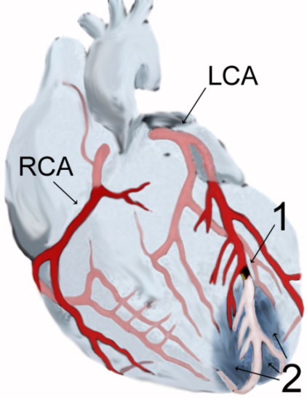
A heart attack often involves a clot in the coronary arteries or their branches.
Note the clot at #1. Area #2 shows the portion of the heart that has been damaged by the clot.
Image by J. Heuser courtesy of Wikipedia.

Slide 30
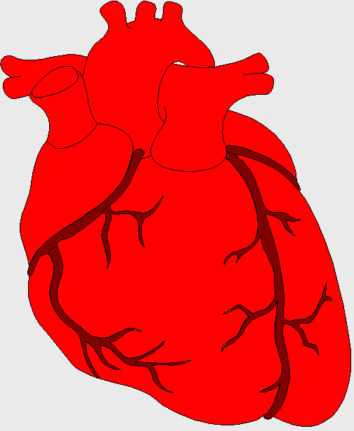
The Heart
This is a vein. It brings blood from the body, except the lungs.
These are arteries. They carry blood away from the heart.
2 atria
Coronary arteries, the hearts own blood supply
2 ventricles
The heart has four chambers
now lets look inside the heart

Slide 31
How the heart works
The wall of the left ventricle is 3x thicker than the right because the right ventricle only pumps blood to the lungs.
  The left ventricle pumps to the whole body
The heart receives its nourishment (blood, oxygen, nutrients) via two coronary arteries

Slide 32
How the Heart Works
When the heart contracts both atria function together, then both ventricles function together
  Both AV valves open into the ventricles
  When the ventricles contract the AV valves close, and the semilunar valves open pushing blood into the arteries (pulmonary or aorta)
We can hear the heartbeat with a stethoscope

Slide 33
How does the Heart work?
STEP ONE
blood from the body
blood from the lungs
The heart beat begins when the
heart muscles relax and blood
flows into the atria.

Slide 34
How does the Heart work?
STEP TWO
The atria then contract and
the valves open to allow blood
into the ventricles.

Slide 35
How does the Heart work?
STEP THREE
The valves close to stop blood
flowing backwards.
The ventricles contract forcing
the blood to leave the heart.
At the same time, the atria are
relaxing and once again filling with
blood.
The cycle then repeats itself.

Slide 36
Heart Beat
Normal heart beat sounds are “lub-dub”…..
Shhh…. Sounds or lub-lub-dub or lub-dub-dub indicates malfunctions
  Shhhhh……. Is sometimes caused by damaged heart valves
    Heart disorders may include
      Heart murmur- usually caused by defective heart valves
      Arrhythmia- abnormal heart beat

Slide 37
what’s in
digested food
red blood cells
white blood cells
BLOOD
oxygen
waste (urea)
carbon dioxide
platelets
plasma
hormones

Slide 38
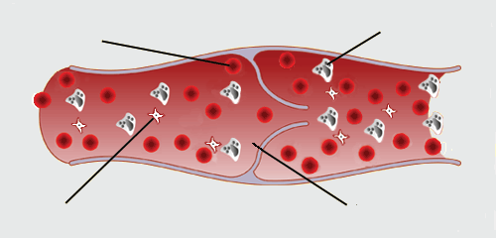
The Blood
red blood cell
white blood cell
platelets
plasma

Slide 39
The Blood
Your body has 3-5 liters of blood running through it at all times
Blood can be separated into three parts
  Red blood cells- heaviest layer, makes up less than half of the total composition
  Blood plasma- top layer, more than half of the blood’s composition
  White blood cells- middle, lightest layer; thinnest layer, made of white blood cells and platelets

Slide 40
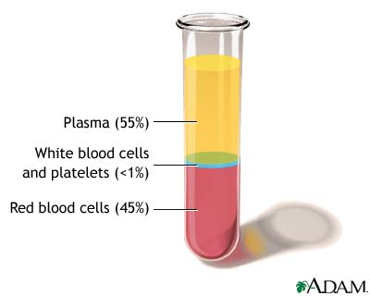
Blood Composition

Slide 41
Red Blood Cells
Erythrocytes- red blood cells; made in the bone marrow
    Erythro- red
    Cytes- cells
  Contain hemoglobin: iron-containing pigment in the blood
    Carries oxygen through the blood vessels to the body

Slide 42
Red Blood Cells
    Blood Disorders
    Anemia- lack of hemoglobin, which diminishes the amount of oxygen in the body
      Symptoms
        Tired
        Pale
        Fainting/dizziness
      Treatment
        Intake more iron
          Diet (eat iron rich foods; red meat and beans are great!)
          Through supplements (vitamins)

Slide 43
Anemia is a condition caused by low levels of red blood cells and hemoglobin.
Anemia can be caused by the following:
Loss of blood due to injury,
Infestations of blood-sucking parasites, or
Low levels of red cell production due to poor nutrition.

Slide 44
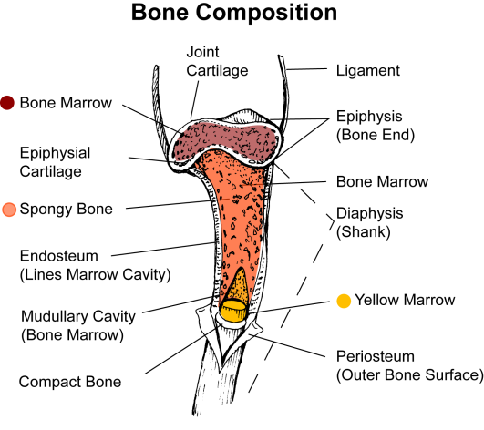
Red blood cells are produced in the red marrow of bones.

Slide 45
Leukocytes
Leukocyte= White Blood Cells
    Leuko= white
    Cyte= cell
  Some leukocytes destroy bacteria and other foreign matter by engulfing and digesting them
  Responsible for making antibodies
    Chemical that attacks invading organism or poisons
      They are the little soldier of your immune system

Slide 46
White Blood Cells
When bacterial infections occur, the number of white blood cells normally increases.
When viral infections occur, the number of white blood cells normally decreases.
Therefore, the concentration of white blood cells can help diagnose disease.

Slide 47
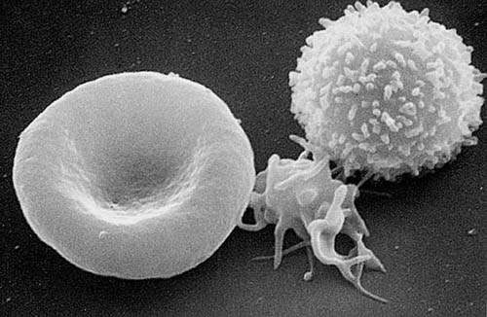
From left to right: Red blood cell (erythrocyte); Platelet (thrombocyte); White blood cell (leukocyte).
Photo from U. S. Federal Government courtesy of Wikipedia.

Slide 48
Platelets and blood clotting
Platelets are small fragments that help the blood to clot
  They may secrete a substance that causes the clot to contract and solidify.
Platelets may also secrete a substance that causes an injured vessel to constrict at the injury.

Slide 49
Blood Plasma
Plasma, which makes up 50 – 65% of the total volume of blood, is a straw-colored liquid containing water (90%) and solids (10%).
The solids in plasma include inorganic salts and organic substances such as antibodies, hormones, vitamins, enzymes, proteins, and glucose (blood sugar).

Slide 50
SUMMARY
Arteries take blood ______ from the heart. The walls of an artery are made up of thick _________ walls and elastic fibers. Veins carry blood ________ the heart and also have valves. The _________ link arteries and veins, and have a one cell thick wall. Blood is made up of four main things ______, the liquid part of the blood; Red Blood Cells to carry ______; White Blood cells to protect the body from disease and _________ to help blood clot.
away
muscular
towards
capillaries
plasma
oxygen
platelets

Slide 51
Blood Pressure
The pressure of circulating blood against the walls of the arteries is called the blood pressure
You can feel the pumping of blood by pressing an artery against a bone in what is called the pulse

Slide 52
Blood Pressure
Disorders:
  Low blood pressure will cause the cells not to receive adequate nourishment
    Can cause a loss of consciousness
  High blood pressure can be caused by age, tension, diet and medications

Slide 53
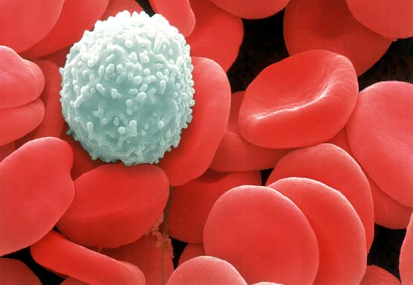
The Body’s Defense System
Our body’s are designed to resist or overcome disease
  It does this through our immune system

Slide 54
Introduction
The immune system must be able to: differentiate between material that is a normal component of the body (“self”) and material that is not native to the body “nonself”
A highly specialized receptors present for discriminating between ”self” and “nonself” body components

Slide 55
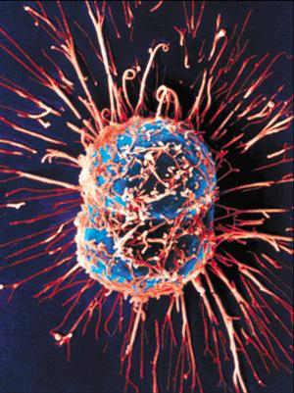
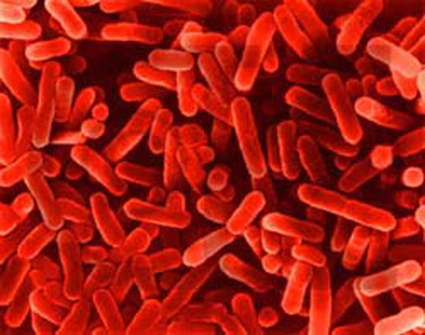

What is the immune system?
The body’s defense against disease causing organisms, malfunctioning cells, and foreign particles
      These are called PATHOGENS

Slide 56
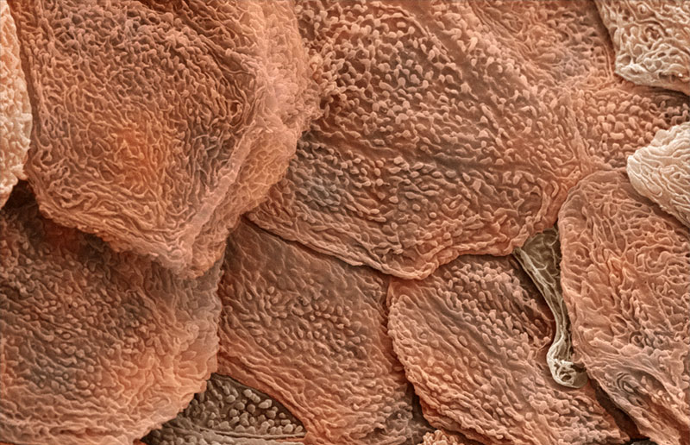
The First Line of Defense
~Skin~
The dead, outer layer of skin, known as the epidermis, forms a shield against invaders and secretes chemicals that kill potential invaders
You shed between 40 – 50 thousand skin cells every day!

Slide 57
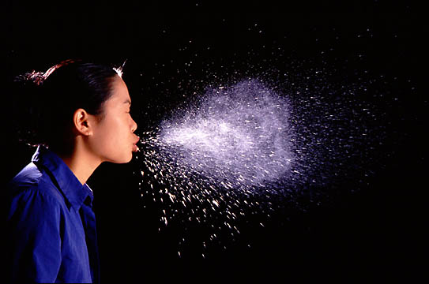
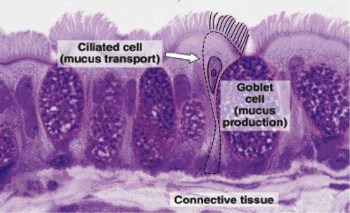
The First Line of Defense
~Mucus and Cilia~
As you breathe in, foreign particles and bacteria bump into mucus throughout your respiratory system and become stuck
Hair-like structures called cilia sweep this mucus into the throat for coughing or swallowing
Don’t swallowed bacteria have a good chance of infecting you?

Slide 58
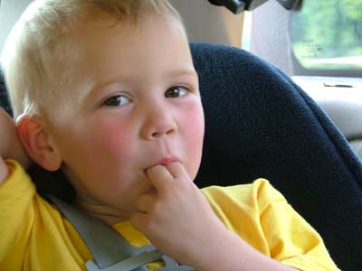
The First Line of Defense
~Saliva~
What’s the first thing you do when you cut your finger?
Saliva contains many chemicals that break down bacteria
Thousands of different types of bacteria can survive these chemicals, however

Slide 59
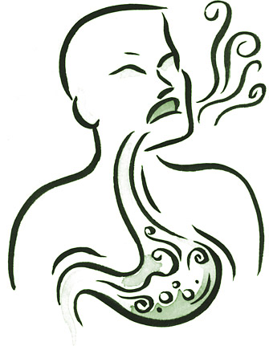
The First Line of Defense
~Stomach Acid~
Swallowed bacteria are broken down by incredibly strong acids in the stomach that break down your food
The stomach must produce a coating of special mucus or this acid would eat through the stomach!

Slide 60
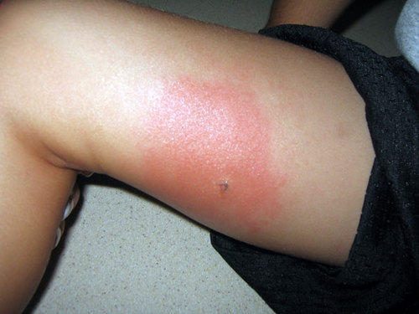
The Second Line of Defense
~The Inflammatory Response~
Injured body cells release chemicals called histamines, which begin inflammatory response
    Capillaries dilate
    Pyrogens released, reach brain (hypothalamus), and temperature rises
    Pain receptors activate
    WBCs flock to infected area like sharks to blood

Slide 61
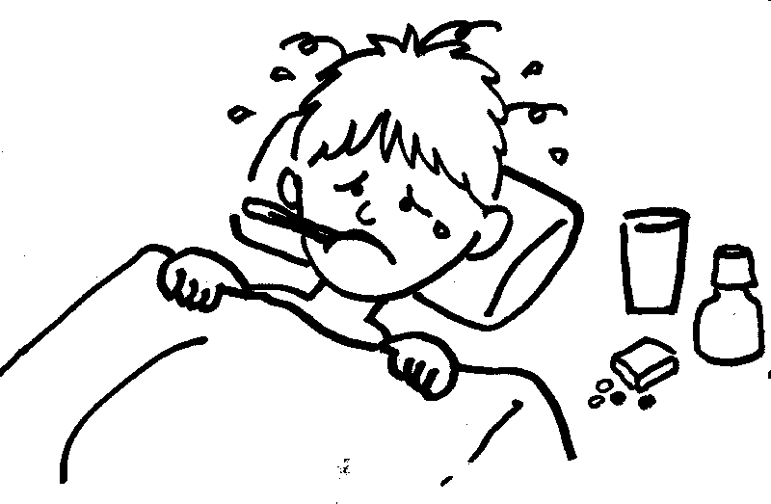
Fever Response
The response to toxins in the body, produced by bacteria, is to increase the internal temperature of the body.
The increase in temperature slows bacterial reproduction and increases the body’s defenses.
The chemicals released at the site of inflammation sends signals to the brain to raise the boy’s temperature

Slide 62
Summary
Nonspecific diseases:
  Our first line of defense is our skin and our mucous membranes
    They intend to block any foreign invaders that seek to harm our bodies
  Cilia line our nose and throat to move out any invaders that make it through
    They are small hair like structures that move particles up and out of the body
  Hydrochloric acid produced by the stomach is another defense mechanism to kill invaders

Slide 63
Summary
Once an organism gets into the body through the skin the next line of defense is activated
  Inflammation: a local response to invaders that causes blood vessels to dilate (become larger) and “leaky” to allow plasma to enter in
  Signals go to the brain to raise body temp to decrease bacterial reproduction

Slide 64
Specific Defenses:
The Immune System
This is your body’s defense strategy against specific pathogens
  Here the White Blood Cells (WBC) are in charge
    They are the generals of your immune army
    In the immune system they are called lymphocytes

Slide 65
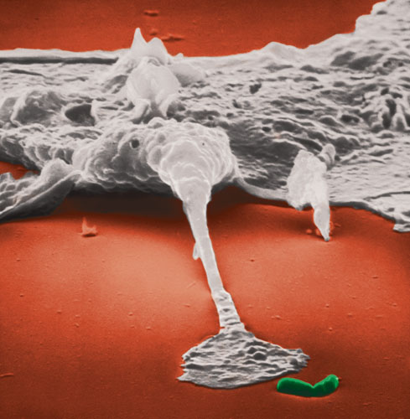
The Second Line of Defense
~White Blood Cells~
If invaders actually get within the body, then your white blood cells (WBCs) begin their attack
WBCs normally circulate throughout the blood, but will enter the body’s tissues if invaders are detected
Video

Slide 66
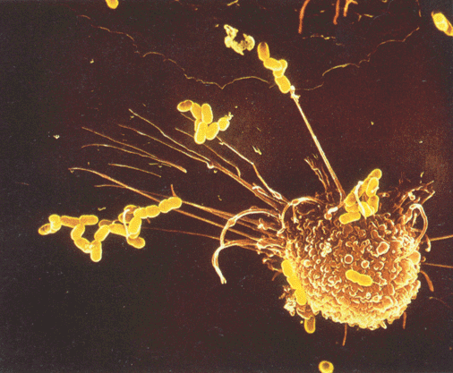
Two Divisions of the Immune System
The efforts of the WBCs known as phagocytes and T-cells is called the cell-mediated immune system.
    Protective factor = living cells
      Phagocytes – eat invaders
      T-cells – kill invaders

Slide 67
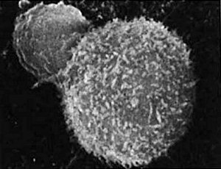
White Blood Cells
~T-Cells~
T-Cells, often called “natural killer” cells, recognize infected human cells and cancer cells
T-cells will attack these infected cells, quickly kill them, and then continue to search for more cells to kill

Slide 68
Two Divisions of the Immune System
The other half of the immune system is called antibody-mediated immunity, meaning that is controlled by antibodies
This represents the third line of defense in the immune system

Slide 69
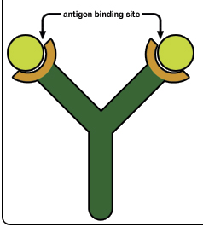
The Third Line of Defense
~Antibodies~
Most infections never make it past the first and second levels of defense
Those that do trigger the production and release of antibodies
    Proteins that latch onto, damage, clump, and slow foreign particles
    Each antibody binds only to one specific binding site, known as an antigen

Slide 70
The Third Line of Defense
~Antibodies~
Most infections never make it past the first and second levels of defense
Those that do trigger the production and release of antibodies
    Proteins that latch onto, damage, clump, and slow foreign particles
    Each antibody binds only to one specific binding site, known as an antigen

Slide 71
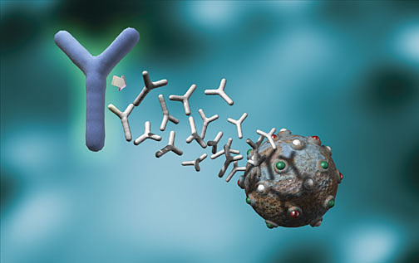
What is immunity?
Resistance to a disease causing organism or harmful substance
Two types
    Active Immunity
    Passive Immunity

Slide 72
Active and Passive Immunity
Active immunity
Lymphocytes are activated by antigens on the surface of pathogens
Natural active immunity - acquired due to infection
Artificial active immunity – vaccination
Takes time for enough B and T cells to be produced to mount an effective response.

Slide 73
Active Immunity
You produce the antibodies
  Your body has been exposed to the antigen in the past either through:
    Exposure to the actual disease causing antigen – You fought it, you won, you remember it
    Planned exposure to a form of the antigen that has been killed or weakened – You detected it, eliminated it, and remember it
What is this second type of exposure called?

Slide 74
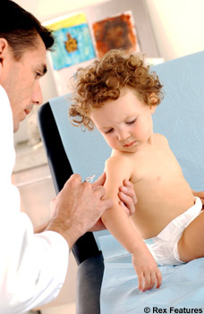
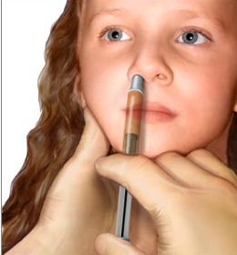
Vaccine
Antigens are deliberately introduced into the immune system to produce immunity
Because the bacteria has been killed or weakened, minimal symptoms occur
Have eradicated or severely limited several diseases from the face of the Earth, such as polio and smallpox

Slide 75
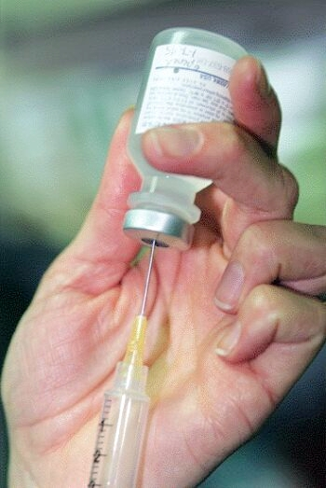
How long does active immunity last?
It depends on the antigen
Some disease-causing bacteria multiply into new forms that our body doesn’t recognize, requiring annual vaccinations, like the flu shot
Booster shot - reminds the immune system of the antigen
Others last for a lifetime, such as chicken pox

Slide 76
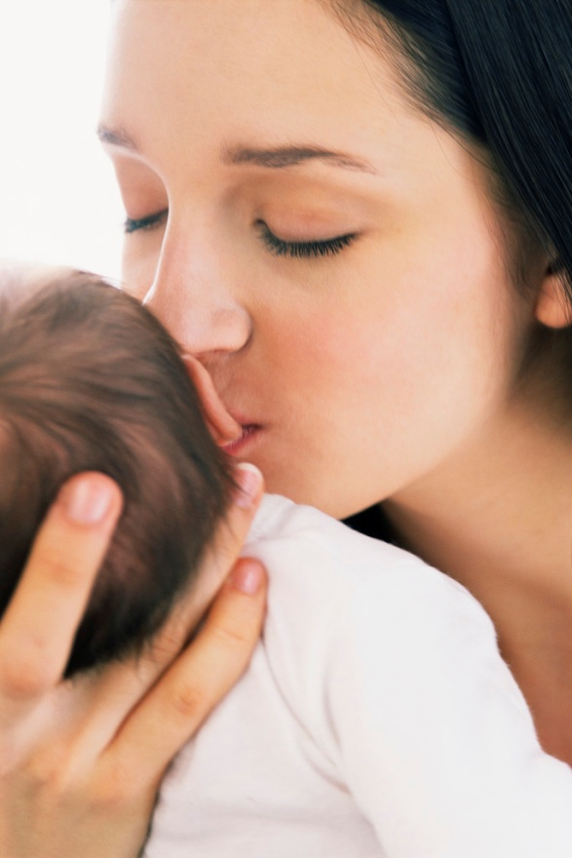
Passive Immunity
You don’t produce the antibodies
  A mother will pass immunities on to her baby during pregnancy - through what organ?
  These antibodies will protect the baby for a short period of time following birth while its immune system develops. What endocrine gland is responsible for this?
  Lasts until antibodies die
Placenta
Thymus
Why doesn’t the mother just pass on the WBCs that “remember” the antigens?

Slide 77
Active and Passive Immunity
Passive immunity
B and T cells are not activated and plasma cells have not produced antibodies.
The antigen doesn’t have to be encountered for the body to make the antibodies.
Antibodies appear immediately in blood but protection is only temporary.

Slide 78
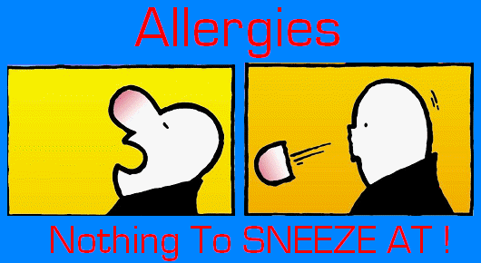
Immune Disorders
~Allergies~
Immune system mistakenly recognizes harmless foreign particles as serious threats
Launches immune response, which causes sneezing, runny nose, and watery eyes
Anti-histamines block effect of histamines and bring relief to allergy sufferers

Slide 79
Self vs. Not Self
Like most systems things can go wrong, such as when the immune system attacks itself, not recognizing the proteins that code a cell as “self.” When this happens it is known as an autoimmune disease.
In the case of tissue implants, they may be rejected if the tissue cells don’t have the proper proteins to inactivate the complement system in a different humans body. So the complement kills the cells!
In order for tissues to be accepted they also must have the proper MHC complex to pass as human cells, these proteins must be on the surface of the cells, as either of the two classes.

Slide 80
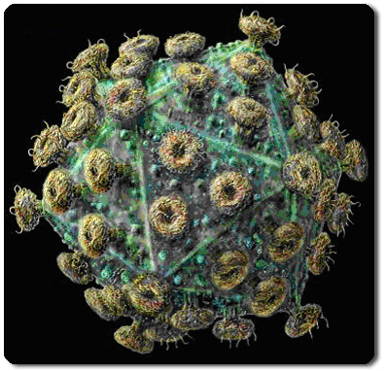
Aquired Immune Deficiency Syndrome
Caused by the Human Immunodeficiency Virus
Discovered in 1983
Specifically targets and kills T-cells
Because normal body cells are unaffected, immune response is not launched

Slide 81
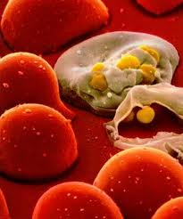
AIDS
~The Modern Plague~
The HIV virus doesn’t kill you – it cripples your immune system
With your immune system shut down, common diseases that your immune system normally could defeat become life-threatening
Can show no effects for several months all the way up to 10 years

Slide 82
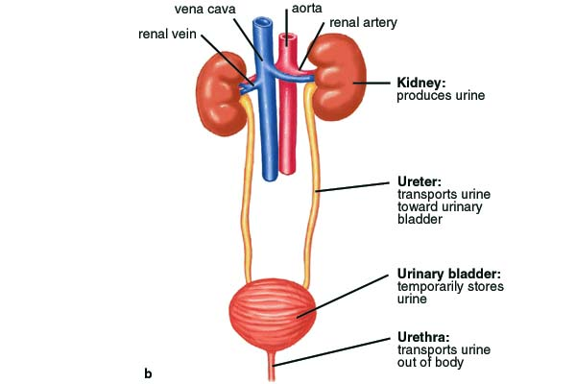
Human Excretory System

Slide 83
Excretory System
The kidneys regulate the amount of water, salts and other substances in the blood.
The kidneys are fist-sized, bean shaped structures that remove nitrogenous wastes (urine) and excess salts from the blood.
The ureters are tubes that carry urine from the pelvis of the kidneys to the urinary bladder.
The urinary bladder temporarily stores urine until it is released from the body.
The urethra is the tube that carries urine from the urinary bladder to the outside of the body.
The outer end of the urethra is controlled by a circular muscle called a sphincter.

Slide 84
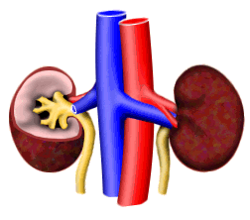
Kidneys
Two reddish organs just above the waist behind the stomach
Filter the blood and removes waste

Slide 85
The Job of the Kidneys
They are responsible for cleaning the blood by removing metabolic wastes, excess solutes, and excess water and excreting them as urine
Besides removing urea, it also removes excess salts or glucose, the remnants of drugs (reason for urine tests), and excess water.

Slide 86
Function of the Kidney
The principal function of the kidney is to filter blood in order to remove cellular waste products from the body.
At any given time, 20 % of blood is in the kidneys. Humans can function with one kidney.
If one ceases to work, the other increases in size to handle the workload.

Slide 87
NOTE
Since the kidneys control what leaves and what remains in the nephrons, they maintain the levels of water, ions and other materials nearly constant and within the limits to maintain homeostasis.

Slide 88
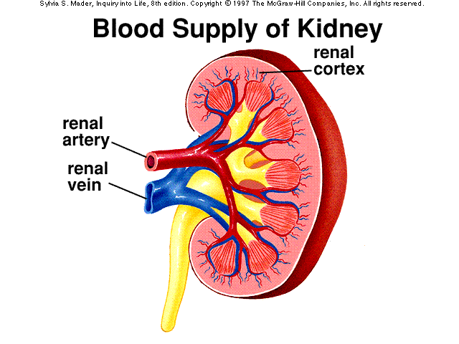

Slide 89
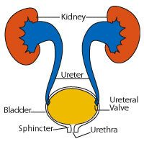
Urinary Bladder
Smooth muscle bag
Stores waste solution - urine

Slide 90
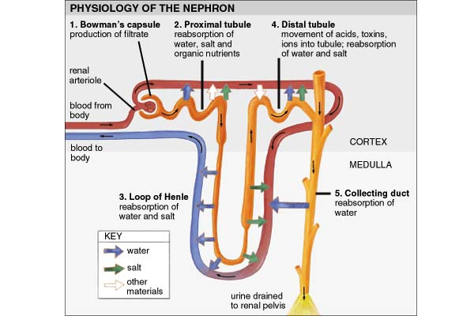

Slide 91
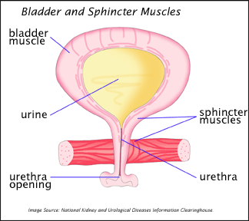
Urethra
Connects bladder to outside of the body
Allows urine to pass out of the body

Slide 92
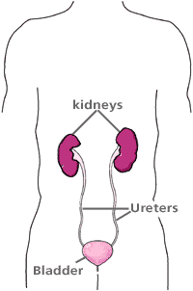
Ureter
Connects the kidneys to the urinary bladder

Slide 93
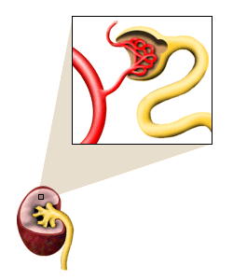
Nephron
Filtering unit of the kidney
Blood enters full of waste and leaves filtered
Blood enters under high pressure and flows into the capillary beds

Slide 94
Regulation of Water Levels
If the blood becomes too dilute or too concentrated with solutes, then it can interfere with normal cellular activity.
The kidneys are able to regulate water concentration in the blood by removing excess water if the blood is too dilute or conserving water in the blood if it is not dilute enough

Slide 95
Waste Products
Carbon dioxide – a waste product of cellular respiration is dumped into the blood stream and eventually removed by the lungs
Ammonia (NH₃) is removed through water
  This waste comes from the cells breakdown of old proteins
  It is also what makes bleach smell so in high concentrations it is poisonous to the cells and must be removed

Slide 96
Formation of Urine
If there is too much water in the blood, then it is removed and put in urine.
If there is not enough water in the blood, the kidneys will not remove it.
If there is too much urea or other solutes in the blood, the kidneys will remove these excess solutes.
By regulating solute numbers and water volume, the kidneys normally maintain homeostasis in blood solute concentration.

Slide 97
Why is excretion necessary?
In order for cells to stay alive, they must continually intake water and other molecules.
The cells would continue to get bigger and bigger if they only took in molecules
They must also export molecules
  These molecules may be important signaling molecules such as hormones, or they may be molecules of glucose on their way to other cells, or they may be waste products of cellular metabolism that cells need to dispose.

Slide 98
Removal of Ammonia
Once excreted into the blood stream by cells, it is carried to the liver where it is converted from ammonia into urea which is much less toxic
It is then carried from the liver to the kidneys where it is removed

Slide 99
Excretory System Problems
Kidney stones – crystalized mineral salts and uric acid salts in the urine. Stones block flow of urine and cause excrutiating pain.
Kidney failure - can be caused by long-term diabetes, infections, physical injuries, chemical poisoning. Causes toxic materials to build up to lethal levels.
Dialysis or kidney transplant is the treatment.

Slide 100
Describe the functions of a person's urinary system
Rids the body of wastes, control blood volume, balances salts & water

Slide 101
Explain how the kidneys remove wastes and keep fluids and salts in balance
Kidneys filter the blood to remove extra wastes, sugar, water, and salt. Sugar, water, and salt still needed by the body is returned to the blood.

Slide 102
Describe what happens when the urinary system does not function properly.
Wastes are not removed. This causes the destruction of cells. Water not removed causes swellings and too much water around the heart. Slats that are not taken away can cause organ damage.

Slide 103
Compare the excretory system and urinary system
The excretory system is made of all body organs that get rid of wastes. The urinary system is made of organs that produce urine as a waste.

Slide 104
How is your urinary system similar to a water-purification system?
It serves as a filter to screen out harmful materials and helps get rid of wastes in the blood

Slide 105
When you drink a lot of water, you also need to urinate often. Why?
The job of the kidneys is to eliminate excess water and wastes. If you drink more than your body needs, it is eliminated by the urinary system.

