Slide 1

Magnetism

Slide 2
Top Ten List
What We Will Learn About Magnetism
1. There are North Poles and South Poles.
2. Like poles repel, unlike poles attract.
3. Magnetic forces attract only magnetic materials.
4. Magnetic forces act at a distance.
5. While magnetized, temporary magnets act like permanent magnets.

Slide 3
Top Ten continued…
6. A coil of wire with an electric current flowing through it becomes a magnet.
7. Putting iron inside a current-carrying coil increases the strength of the electromagnet.
8. A changing magnetic field induces an electric current in a conductor.

Slide 4
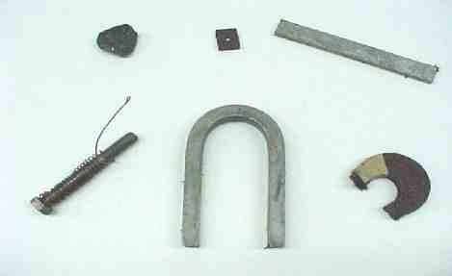
Types of Magnets
BAR
LOADSTONE
U
COIL
ALNICO

Slide 5
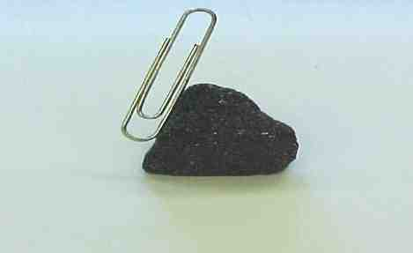
Natural Magnet
Material is Magnetite or Iron Oxide (Fe₂ 0₃)
Notes:
A natural magnet from the Earth known as a loadstone is attracting a paper clip

Slide 6
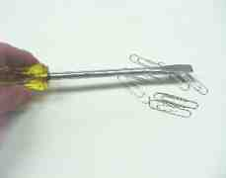
Creating Magnets
Methods used to create a magnet
The picture shows that a screwdriver does not pick up paper clips.

Slide 7
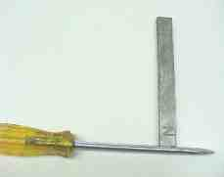
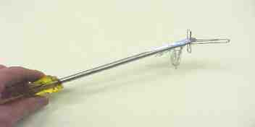
Creating Magnets
Stroking using a permanent magnet
However, after stroking the screwdriver with a magnet, the blade itself becomes magnetic and attracts the paper clips.

Slide 8

What is Magnetism?
Magnetism is the force of attraction or repulsion of a magnetic material due to the arrangement of its atoms, particularly its electrons.
Magnets produce magnetic forces and have magnetic field lines
The ends of a magnet are where the magnetic effect is the strongest. These are called “poles.” Each magnet has 2 poles – 1 north, 1 south.

Slide 9
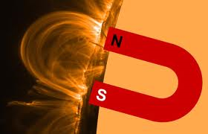
Poles of a magnet always come in pairs!

Slide 10
No Monopoles Allowed
It has not been shown to be possible to end up with a single North pole or a single South pole, which is a monopole ("mono" means one or single, thus one pole).
Note: Some theorists believe that magnetic monopoles may have been made in the early Universe. So far, none have been detected.
S
N

Slide 11
For Every North, There is a South
Every magnet has at least one north pole and one south pole. By convention, we say that the magnetic field lines leave the North end of a magnet and enter the South end of a magnet.
If you take a bar magnet and break it into two pieces, each piece will again have a North pole and a South pole. If you take one of those pieces and break it into two, each of the smaller pieces will have a North pole and a South pole. No matter how small the pieces of the magnet become, each piece will have a North pole and a South pole.
S
N
S
N
S
N

Slide 12
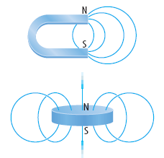

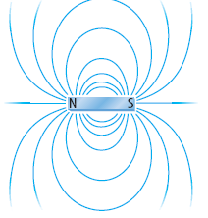
Magnets have two ends or poles, called north and south poles. At the poles of a magnet, the magnetic field lines are closer together.
Unlike poles of magnets attract each other and like poles of magnets repel.

Slide 13
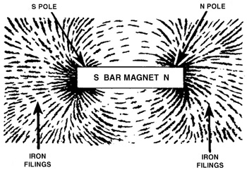
Magnetic Fields
The region where the magnetic forces
act is called the “magnetic field”

Slide 14

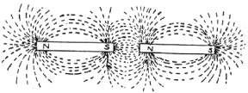
Law Of Magnetism
Like repels like…
Opposites attract!

Slide 15
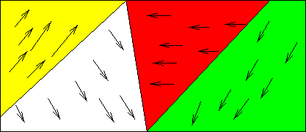
Atoms themselves have magnetic properties due
to the spin of the atom’s electrons.
Groups of atoms join so that their magnetic fields are all going in the same direction
These areas of atoms are called “domains”

Slide 16
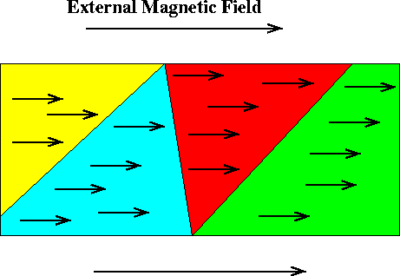
When an non-magnetized substance is placed in a magnetic
field, the substance can become magnetized.
This happens when the spinning electrons line up in the
same direction.

Slide 17

An Non-magnetized substance looks like
this…

Slide 18
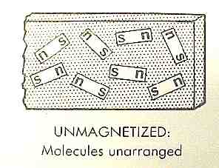
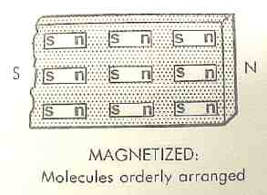
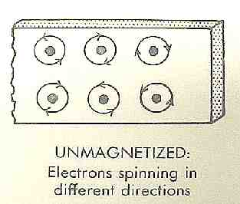
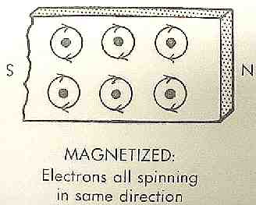
Theory of Magnetism
Molecular and Electron Theories

Slide 19
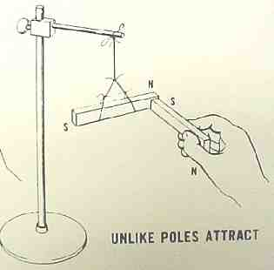
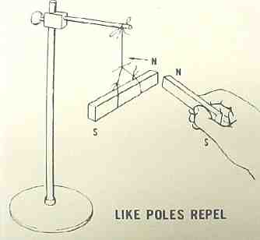
Laws of Magnets
Poles attract or repel

Slide 20
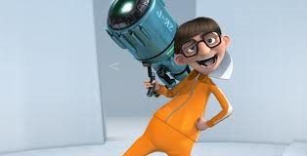
Magnets Have Magnetic Fields
We will say that a moving charge sets up in the space around it a magnetic field,
and
it is the magnetic field which exerts a force on any other charge moving through it.
Magnetic fields are vector quantities….that is, they have a magnitude and a direction!

Slide 21
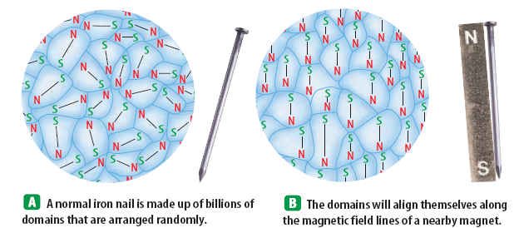
What are magnetic domains?
Magnetic substances like iron, cobalt, and nickel are composed of small areas where the groups of atoms are aligned like the poles of a magnet.
These regions are called domains.
  All of the domains of a magnetic substance tend to align themselves in the same direction when placed in a magnetic field.
  These domains are typically composed of billions of atoms.

Slide 22
Magnetic Properties of Matter
All substances - solid, gas, and liquid - react to the presence of a magnetic field on some level. Remember why?
How much they react causes them to be put into several material “types”.

Slide 23
Magnet - isms
Ferromagnetism – Ferromagnetic materials, such as iron, nickel, cobalt, liquid oxygen, steel, and alnico, make good magnets and focus and strengthen an external magnetic field
  They will align themselves, creating magnetic domains forming a permanent magnet.
  If a piece of iron is placed within a strong magnetic field, the domains in line with the field will grow in size as the domains perpendicular to the field will shrink in size.

Slide 24
Making a Magnet from a Ferromagnetic Material
• domains in which the magnetic fields of individual atoms align
• orientation of the magnetic fields of the domains is random
• no net magnetic field.
• when an external magnetic field is applied, the magnetic fields of the individual domains line up in the direction of the external field
• this causes the external magnetic field to be enhanced

Slide 25
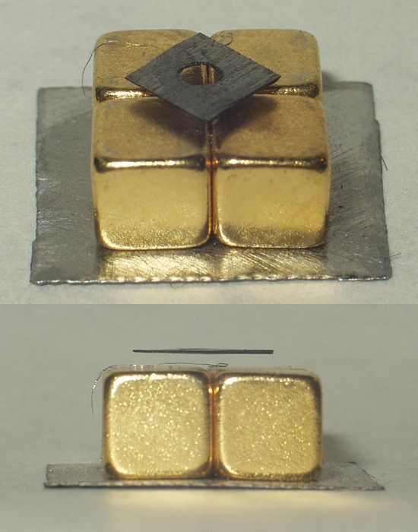
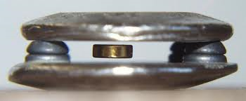
Magnetic Properties
Diamagnetism- weakens the external magnetic field by generating (making) an opposing field (a field that goes against the existing magnetic field)
  This can cause levitation

Slide 26
More Magnet - isms
Diamagnetism – weakens an external magnetic field by making an opposing field.
It is exhibited by all common materials, but is very weak.
People and frogs are diamagnetic.
Metals such as bismuth, copper, gold, silver and lead, as well as many nonmetals such as water and most organic compounds are diamagnetic.

Slide 27
More Magnet - isms
Paramagnetism - When a paramagnetic material is placed near a magnet, it will be attracted to the region of greater magnetic field, like a ferromagnetic material.
The difference is that the attraction is weak.
It is exhibited by materials containing transition elements, rare earth elements and actinide elements.
Liquid oxygen and aluminum are examples of paramagnetic materials.

Slide 28
MAGNETIC TERMS
Ferromagnetic Material – A material easy to magnetize. (i.e., Iron Steel, Cobalt, Perm-alloy, and Alnico)
Paramagnetic Material- A material that can be slightly magnetized.
Diamagnetic Material – A material that is very difficult to magnetize.
Magnetic Laws – Simply stated: Like poles repel and unlike poles attract.

Slide 29
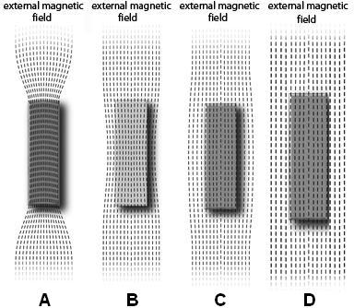
What Type of Magnetism is it?
A= Ferromagnetic
B= Paramagnetic
C= Diamagnetic
D= Non-Magnetic

Slide 30
Magnetism and Temperature
Does temperature effect magnetism?
  Yes
  How?
  Let us think…..
    Temperature increases causes particles to move faster
    So great increases in temperature will decrease magnetism
      Temperatures of 770 C will cause the magnet to quickly lose its magnetic effects- this is the Curie Temperature

Slide 31
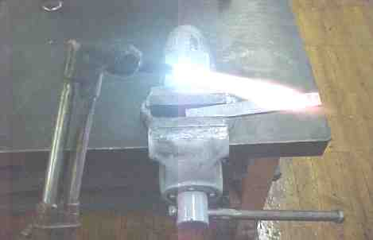
Removing Magnetism
Heat is one way to remove magnetism.

Slide 32
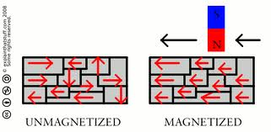
How to break a magnet:
1. Drop it
2. Heat it
This causes the domains to become random again!

Slide 33
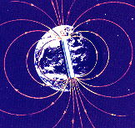
The Earth is a magnet:
Geographic North Pole
It exerts magnetic forces and is surrounded by a
magnetic field that is strongest near the
North and South
magnetic poles
Magnetic South
Pole
Magnetic North
Pole
Geographic South Pole

Slide 34
We use the Earth’s magnetic field to find direction.
The needle of a compass always points toward the magnetic south pole.
We call this direction “North”
(remember, opposites attract)

Slide 35
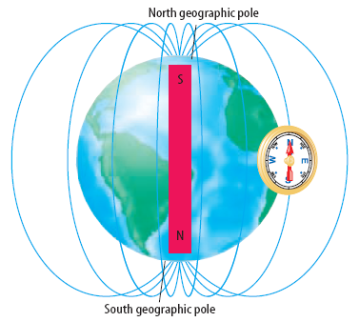
The earth is like a giant magnet!
The nickel iron core of the earth gives the earth a magnetic field much like a bar magnet.

Slide 36
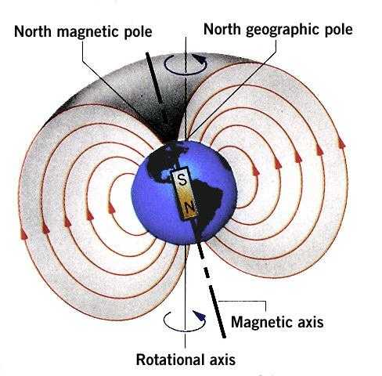
Action at a Distance Explained
Although two magnets may not be touching, they still interact through their
magnetic fields.
This explains the ‘action at a distance’, say of a compass.

Slide 37
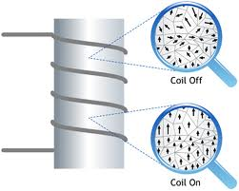
Electromagnetism
Electricity and magnetism are different facets of electromagnetism
  a moving electric charge produces magnetic fields
  changing magnetic fields move electric charges
  The magnetic field is
  temporary, it is only in
  effect when the current is
  flowing.

Slide 38
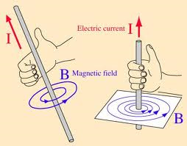
Electromagnetism
Right-hand rule of magnetism says that as you grasp a wire so your right thumb points in the direction of the flow of conventional current, the magnetic lines of force caused by the current will point in the direction your fingers wrap around the wire.

Slide 39
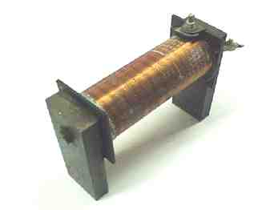
Magnets
A very strong magnet can be made with a coil of wire and the flow of an electric current.

Slide 40
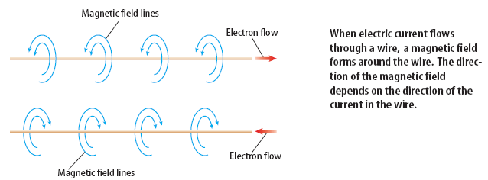
Electricity and Magnetism – how are they related?
When an electric current passes through a wire a magnetic field is formed.

Slide 41
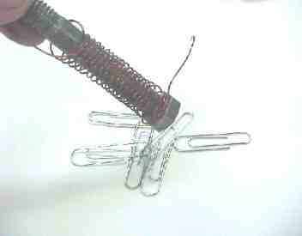
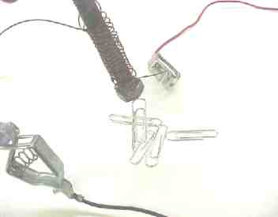
Electromagnets
A coil of wire can be made into a magnet by passing an electric current through it.
Without electricity, there is no magnetic force
Electric current applied to a coil creates a magnetic field

Slide 42
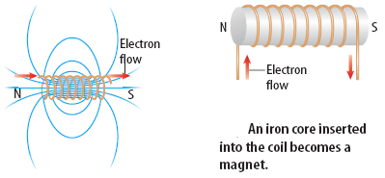
What is an electromagnet?
When an electric current is passed through a coil of wire wrapped around a metal core, a very strong magnetic field is produced. This is called an electromagnet.

Slide 43
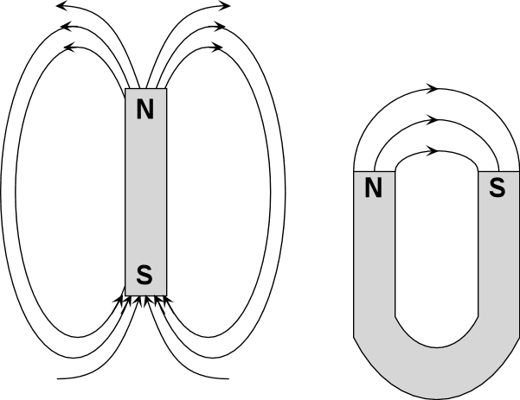
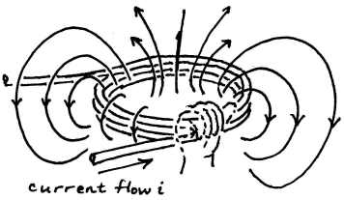
Electromagnets
Arranging wire in a coil and running a current through produces a magnetic field that looks a lot like a bar magnet
  called an electromagnet
  putting a real magnet inside, can shove the magnet back and forth depending on current direction: called a solenoid

Slide 44
Electromagnetic Strength
How can an electromagnet be made stronger?
Increase the number of coils.
Increase the electric current flowing through
the coil.
Add an iron core in the center of the coil.

Slide 45
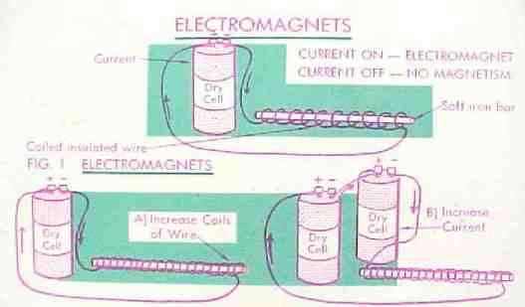
Electromagnetic Strength

Slide 46
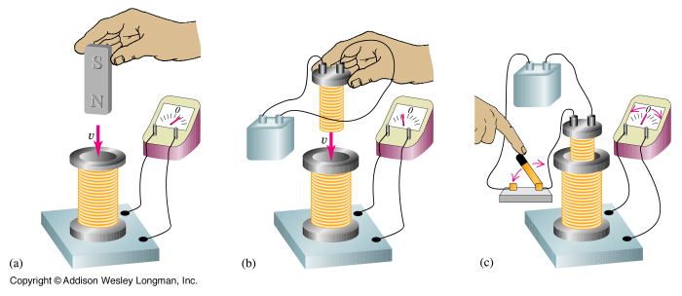
Induced Current
The next part of the story is that a changing magnetic field produces an electric current in a loop surrounding the field
  called electromagnetic induction, or Faraday’s Law

Slide 47
We have seen how electricity can produce a magnetic field, but a magnetic field can also produce electricity! How?
What is electromagnetic induction?
Moving a loop of wire through a magnetic field produces an electric current. This is electromagnetic induction.
A generator is used to convert mechanical energy into electrical energy by electromagnetic induction.

Slide 48
The Electromagnetic Connection
A changing magnetic field produces an electric field, and a changing electric field produces a magnetic field.
Electric and Magnetic fields can produce forces on charges
An accelerating charge produces electromagnetic waves (radiation)
Both electric and magnetic fields can transport energy
  Electric field energy used in electrical circuits, e.g., released in lightning
  Magnetic field carries energy through transformer, for example

Slide 49
Generators and Alternating Current
Electrical generators convert rotational mechanical energy into electrical energy.
  They are composed of several parts:
    Prime Mover: rotating shaft attached to one or more pairs of strong magnets
    Rotor: a spinning unit inside a ring formed of tightly wound coils of wire (keeping the magnetic field moving continuously through the coil)
    Stator: the ring of coils surrounding the rotor. The ends of the stator connect to the electrical terminals

Slide 50
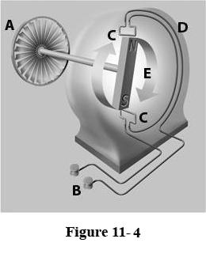
Generators and Alternating Current
Label:
  A- (Turbine) Prime Mover
  B- Output Terminal
  C- Coil
  D- Stator
  E- Rotor

Slide 51
Direct and Alternating Current Generators
Both AC and DC generators have brushes, a magnetic field, electrical terminals, a rotor, and a prime mover; however, most DC generators reverse the locations of the magnets and coils from where they are in an AC generator.
Since the rotor, instead of a magnet, spins in a DC generator, a means of drawing off the current induced in the rotor coils is provided by a split-ring commutator instead of a stator as in an AC generator.
A DC generator provides a one-directional current that varies in strength.
An AC generator provides a current that varies in direction and strength.

Slide 52
Alternating Current Generators
Most of the electricity used in homes today is produced by Alternating Current Generators
  What is special about AC electricity is that the voltage can be readily changed, thus making it more suitable for long-distance transmission than DC electricity.
  But also, AC can employ capacitors and inductors in electronic circuitry, allowing for a wide range of applications.

Slide 53
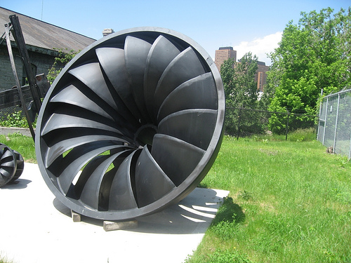
Generator Prime Movers
Electrical generators are used to supply most of our energy we use today.
  This usually comes from a turbine
    A machine that converts the energy of a moving fluid into rotational motion
    It is shaped like a propeller with blades that are moved by the fluid being used to move the turbine

Slide 54
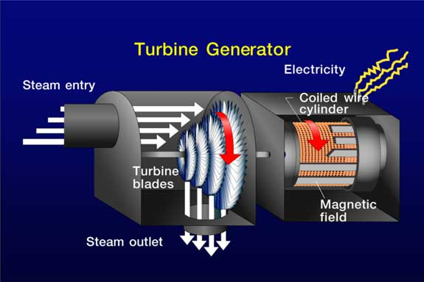
Types of Turbines
Steam turbines- most common prime mover used for commercial generators, use steam to turn the blades
  Large boilers supply steam which turns the turbine and is condensed back to water to be heated again to continually supply steam to turn the turbine

Slide 55
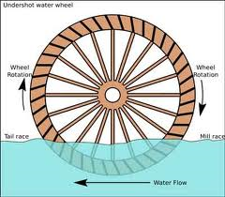
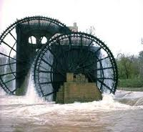
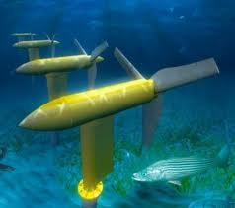
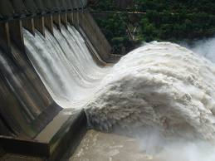
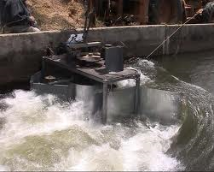
Turbines
Water turbines- used in hydroelectric plants
  They use the gravitational pull of the weight of water to turn the blades of their turbine
DAM
Underwater Turbine

Slide 56
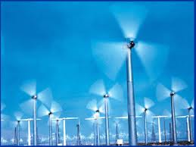
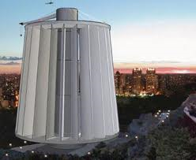
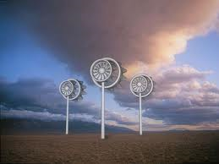
Turbines
Wind Turbines- wind power, as the wind blows the blades turn and create a storable form of energy

Slide 57

Turbines
Gas and diesel generators least efficient and most expensive method of producing electricity with fossil fuels, oil or natural gas.
  Used in jet engines

Slide 58
Direct-Current Generators
Most common electrical appliances (e.g., electric light-bulbs, and electric heating elements) work fine on AC electrical power.
  However, there are some situations in which DC power is preferable.
  For instance, small electric motors (e.g., those which power food mixers and vacuum cleaners) work very well on AC electricity, but very large electric motors (e.g., those which power subway trains) generally work much better on DC electricity.
  Let us investigate how DC electricity can be generated.

Slide 59
Direct-Current Generators
A simple DC generator consists of the same basic elements as a simple AC generator: i.e., a multi-turn coil rotating uniformly in a magnetic field.
The difference is that most direct current generators reverse the location of the magnets from where they are in an AC generator.

Slide 60
Direct-Current Generators
Is composed of magnets mounted on a stator with rotating coils mounted on a rotor. The rotor spins, drawing current from a commutator
  A device that converts the alternating current inside a DC generator to a DC output or converts a DC out put to an alternating current inside a DC motor.
  It is made of segments of metal mounted on the rotor shaft and connected to the individual coils mounted on the rotor of the machine.
  The commutator in a dc generator replaces the slip rings of the ac generator. This is the main difference in their construction.
  The commutator mechanically reverses the connections to the external circuit.

Slide 61


What are electric motors?
An electric motor is a device which changes electrical energy into mechanical energy.

Slide 62

How does an electric motor work?

Slide 63

Simple as that!!

Slide 64
Using Electromagnetism
We use electric and magnetic fields in telephones, radios, computer monitors, and many more items.
Motors are in electric drills, laptop computers, washing machines, etc…
How else do we use electricity and magnetism?

Slide 65
Transformers
A transformer is an apparatus for changing a given electrical current into another current of different voltage.
We call this device a transformer because it transforms electrical energy into magnetic energy, and then back to electrical energy again.
A transformer consists of two coils of wire, both wrapped around the same core.
  The primary coil is the input coil and the secondary coil is the output coil.

Slide 66
Transformers
There are two kinds of transformers: step down and step up.
  Step up transformers increase the voltage
  Step down transformers decrease the voltage.

Slide 67

Step Down Transformers
The coil of the primary (left-hand) or input is wrapped more than the secondary (right-hand)or output coil.
                This causes the output strength/voltage to be less than that of the input

Slide 68

Step-Up Transformer
The coil of the secondary (right-hand)or output is wrapped more than the primary (left-hand) or input coil.
                This causes the output strength/voltage to be more than that of the input

Slide 69
Transformers
Ohm’s law states that current through a conductor is proportional to voltage for a given resistance.
  So if the amount of current in the input coil is lowered by decreasing the number of wraps, the voltage in the output coil will be raised if the wraps on the output is increased.

Slide 70


Transformers
A device that delivers current from one circuit to another through electromagnetic induction is called a transformer.
  Why do power companies use transformers?
    Power companies use transformers to conserve energy and provide a usable voltage of electricity to homes.

Slide 71
Transformers
How do we apply this concept?
  Power is supplied to houses everywhere in the developed world. In the power grid, voltage can be as high as 765000V. This power is stepped down to 72000V at your local substation. From here, the power is stepped down to about 220V at a transformer on a utility pole. The voltage is so high in the beginning so it can travel long distances. It is stepped down so often so it can be used in the home. Certain appliances like air conditioners and stoves use about 220V where smaller appliances use less. If such a high voltage were applied to these appliances they would need step down transformers installed in them.

Slide 72
Transformer Calculations
An electrical substation for your neighborhood includes a transformer that supplies power to your street. Its input coil has 2357 wraps and its output coil has 399 wraps. If the input voltage is 124 kV, what is the voltage of the electrical supply to your street?
V_{out} = ?
V_{in} = 124 kV
N_{out} = 399
N_{in} = 2357

Slide 73
Transformer Calculations
A nuclear power station supplies electricity to customers up to 360 mi away, so it uses a step-up transformer before transmission. Its input electricity is 525 V. The transformer input coil contains 5210 wraps, and the output coil contains 225,670 wraps. What is the transmission voltage of the step-up transformer?
V_{out} = ?
V_{in} = 525 V
N_{out} = 225,670
N_{in} = 5210

Slide 74
Applications of Electromagnets
Electromagnets play an important role in junkyards
  When the electricity flows they are able to pick up large metal items like cars
In recycling centers
  Allowing the center to separate metal items from glass/plastic, requiring the homeowner to place all recyclables in one container

Slide 75
Applications of Electromagnets
In particle accelerators to focus beams of charged particles and bend their paths to keep them from colliding wit the walls of the accelerator
  Some particle accelerators contain special electromagnets called superconducting magnets
    Certain materials that will lose all electrical resistance at extremely low temperatures
    They can maintain high magnetic fields at extremely low temperatures

Slide 76
Applications of Electromagnets
Why are superconducting magnets kept at low temperatures?
  Superconducting magnets are made from materials that lose all resistance at extremely low temperatures. Cooling these magnets maintains their superconductivity.

Slide 77
Applications of Electromagnetism
Electromagnets are used in special electrical switches that are called relays to turn electrical circuits on and off.
  The electrical current passing through a relay can magnetically pull a switch closed or push it open

Slide 78
Review
Diamagnetic materials do not contain dipoles.
Diamagnetic materials strengthen a magnetic field.
The magnetism of lodestones is actually the net result of two kinds of magnetism.
Natural magnets, such as lodestones, display ferrimagnetism.
Magnets strongly attract all metals.
Liquid oxygen and gaseous oxygen display different magnetic properties.
The strongest magnets are made out of pure substances.
False
False
True
True
False
True
False

Slide 79
Review
It is possible for a magnet to have only one pole.
Magnetic fields interact with each other just like electric fields.
A ferromagnetic material above its Curie temperature will behave like a paramagnetic material when it is placed in a magnetic field.
The earth's geomagnetic poles are permanent.
At the geographic North Pole, a compass will point south.
Temperature does not have a strong effect on a ferromagnetic object.
False
True
False
False
True
False

Slide 80
REview
Power substations include collections of step-down transformers.
A solenoid can induce current in a nearby, unconnected solenoid.
Generators can produce only alternating current.
A stator is a pair of solenoids.
A magnet moving back and forth in the center of a coil of wire produces a direct current in the wire.
The earth's magnetic field is important to life on earth.
The earth's magnetic pole nearest the geographic North Pole is a south magnetic pole.
False
False
False
False
False
False
False

